Slide 1
PART 3 Applying Your Testing Skills

Slide 2
Agenda

Slide 3
1. An Overview of Configuration Testing
2. Approaching the Task
3. Obtaining the Hardware
4. Identifying Hardware Standards
5. Configuration Testing Other Hardware

Slide 4
1. An Overview of Configuration Testing
1) Hardware Overview
  The PC
  Components
  Peripherals
  Interfaces
  Options and memory
  Device Drivers

Slide 5












The PC

Slide 6
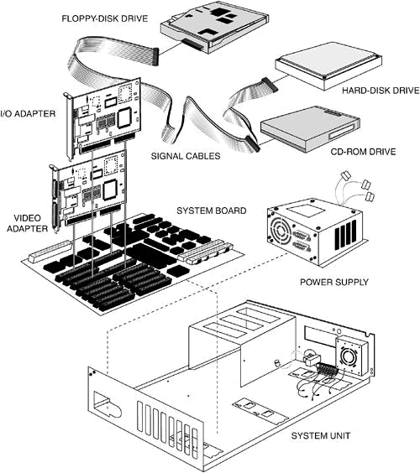
Components

Slide 7
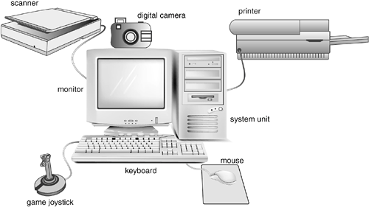
Peripherals

Slide 8
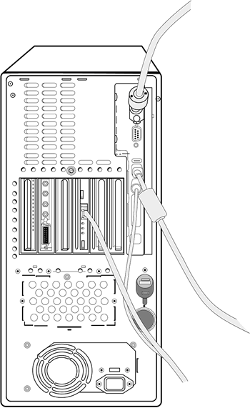
Interfaces

Slide 9
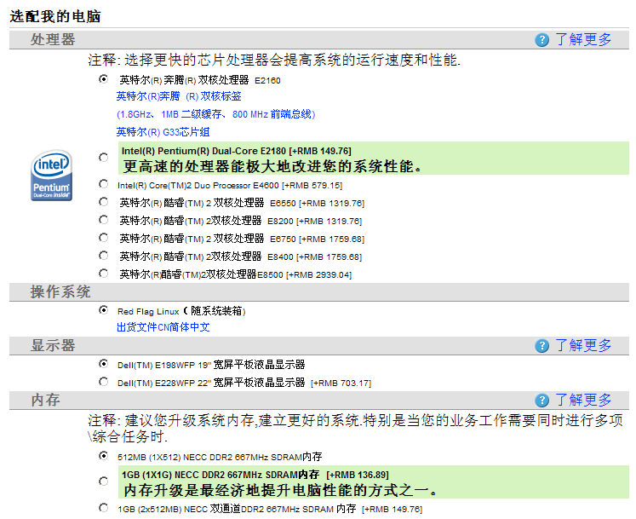
Options and memory

Slide 10
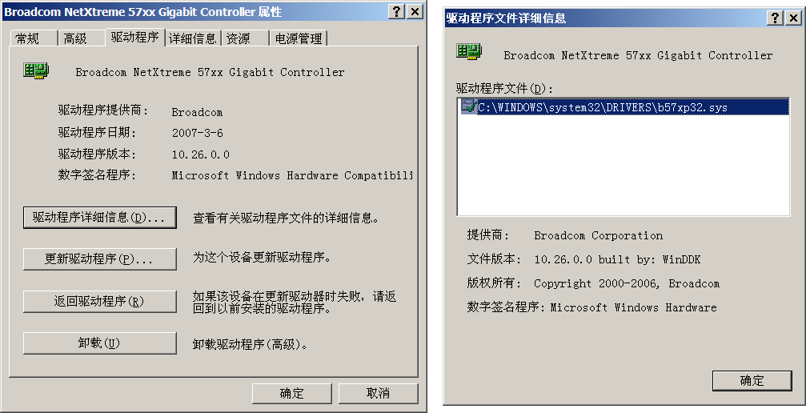
Device Drivers

Slide 11
1. An Overview of Configuration Testing
2) Principle and Problems

Slide 12
1. An Overview of Configuration Testing
3) Isolating Configuration Bugs

Slide 13
1. An Overview of Configuration Testing
4) Sizing Up the Job

Slide 14
1. An Overview of Configuration Testing
1) Hardware Overview
2) Principle and Problems
3) Isolating Configuration Bugs
4) Sizing Up the Job

Slide 15
2. Approaching the Task
Decide the Types of Hardware You'll Need
Decide What Hardware Brands, Models, and Device Drivers Are Available
Decide Which Hardware Features, Modes, and Options Are Possible
Pare Down the Identified Hardware Configurations to a Manageable Set
Identify Your Software's Unique Features That Work with the Hardware Configurations
Design the Test Cases to Run on Each Configuration
Execute the Tests on Each Configuration
Rerun the Tests Until the Results Satisfy Your Team

Slide 16
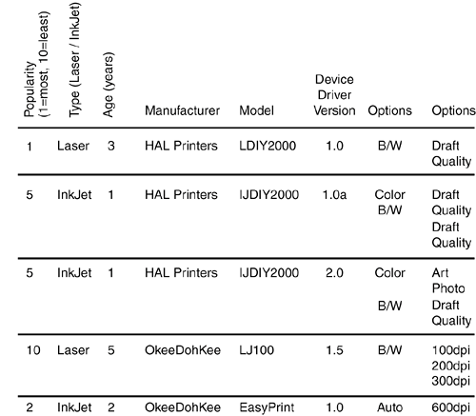

Slide 17
3. Obtaining the Hardware
  Buy only the configurations that you can or will use most often.
  Contact the hardware manufacturers and ask if they will lend or even give you the hardware.
  Send a memo or email to everyone in your company asking what hardware they have in their office or even at home and if they would allow you to run a few tests on it.

Slide 18
4. Identifying Hardware Standards
Apple:
developer.apple.com/hardware
developer.apple.com/testing
PC:
www.microsoft.com/whdc/system/platform
msdn.microsoft.com/certification
www.microsoft.com/whdc/whql

Slide 19
5. Configuration Testing Other Hardware

Slide 20
1. An Overview of Configuration Testing
2. Approaching the Task
3. Obtaining the Hardware
4. Identifying Hardware Standards
5. Configuration Testing Other Hardware

